Slide 1


My Coding Portfolio
A showcase of my coding achievements and skills, providing links to key profiles and projects. This portfolio demonstrates my passion for coding and my commitment to continuous learning. It is designed to highlight my expertise and attract potential collaborators.
by shreeyansh janu

Slide 2
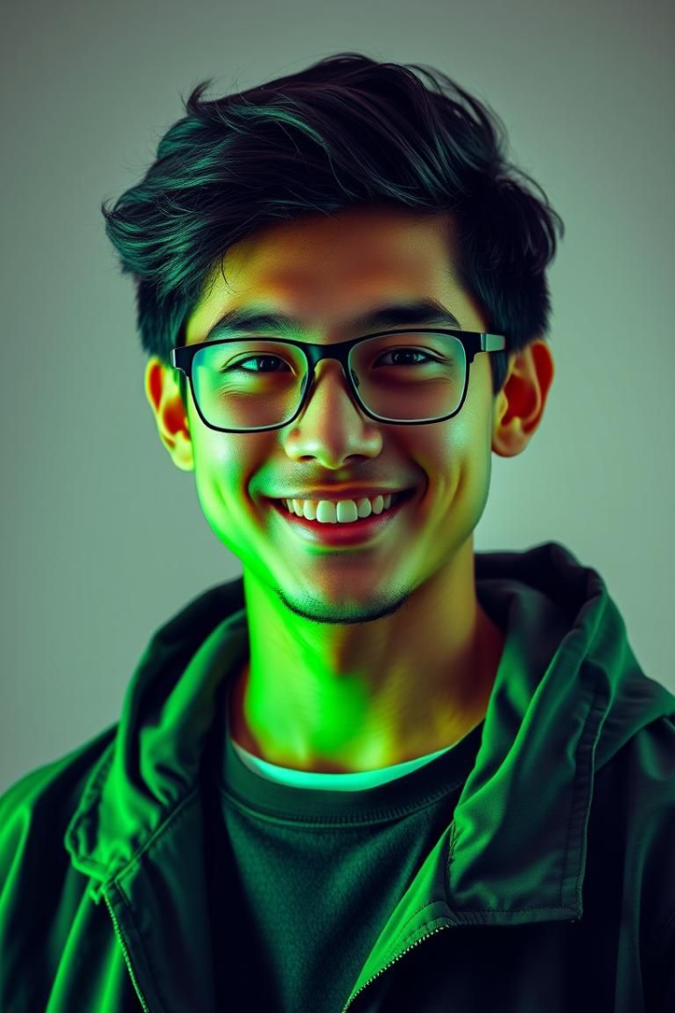
About Me
Introduction
Skills
Driven computer science student with a passion for algorithm design, data structures, and cybersecurity
Proficient in c++,data structure and algorithim
Passion
Dedicated to problem-solving and continuous learning in the field of computer science.

Slide 3
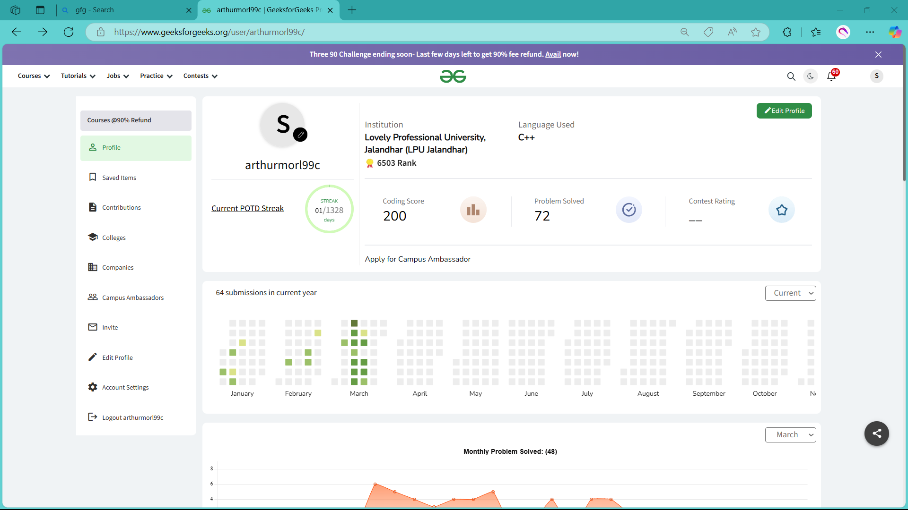


GeeksforGeeks Profile
GFG Profile
Problems Solved
https://www.geeksforgeeks.org/user/arthurmorl99c/
Demonstrated proficiency in solving complex coding problems.

Slide 4
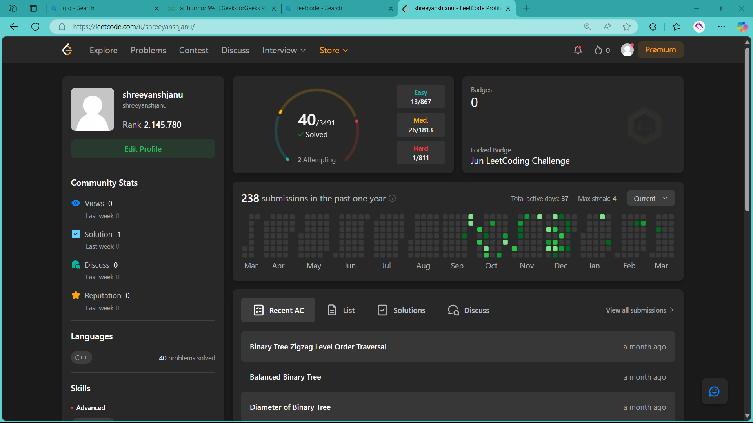

LeetCode Profile
LeetCode Profile
https://leetcode.com/u/shreeyanshjanu/.

Slide 5
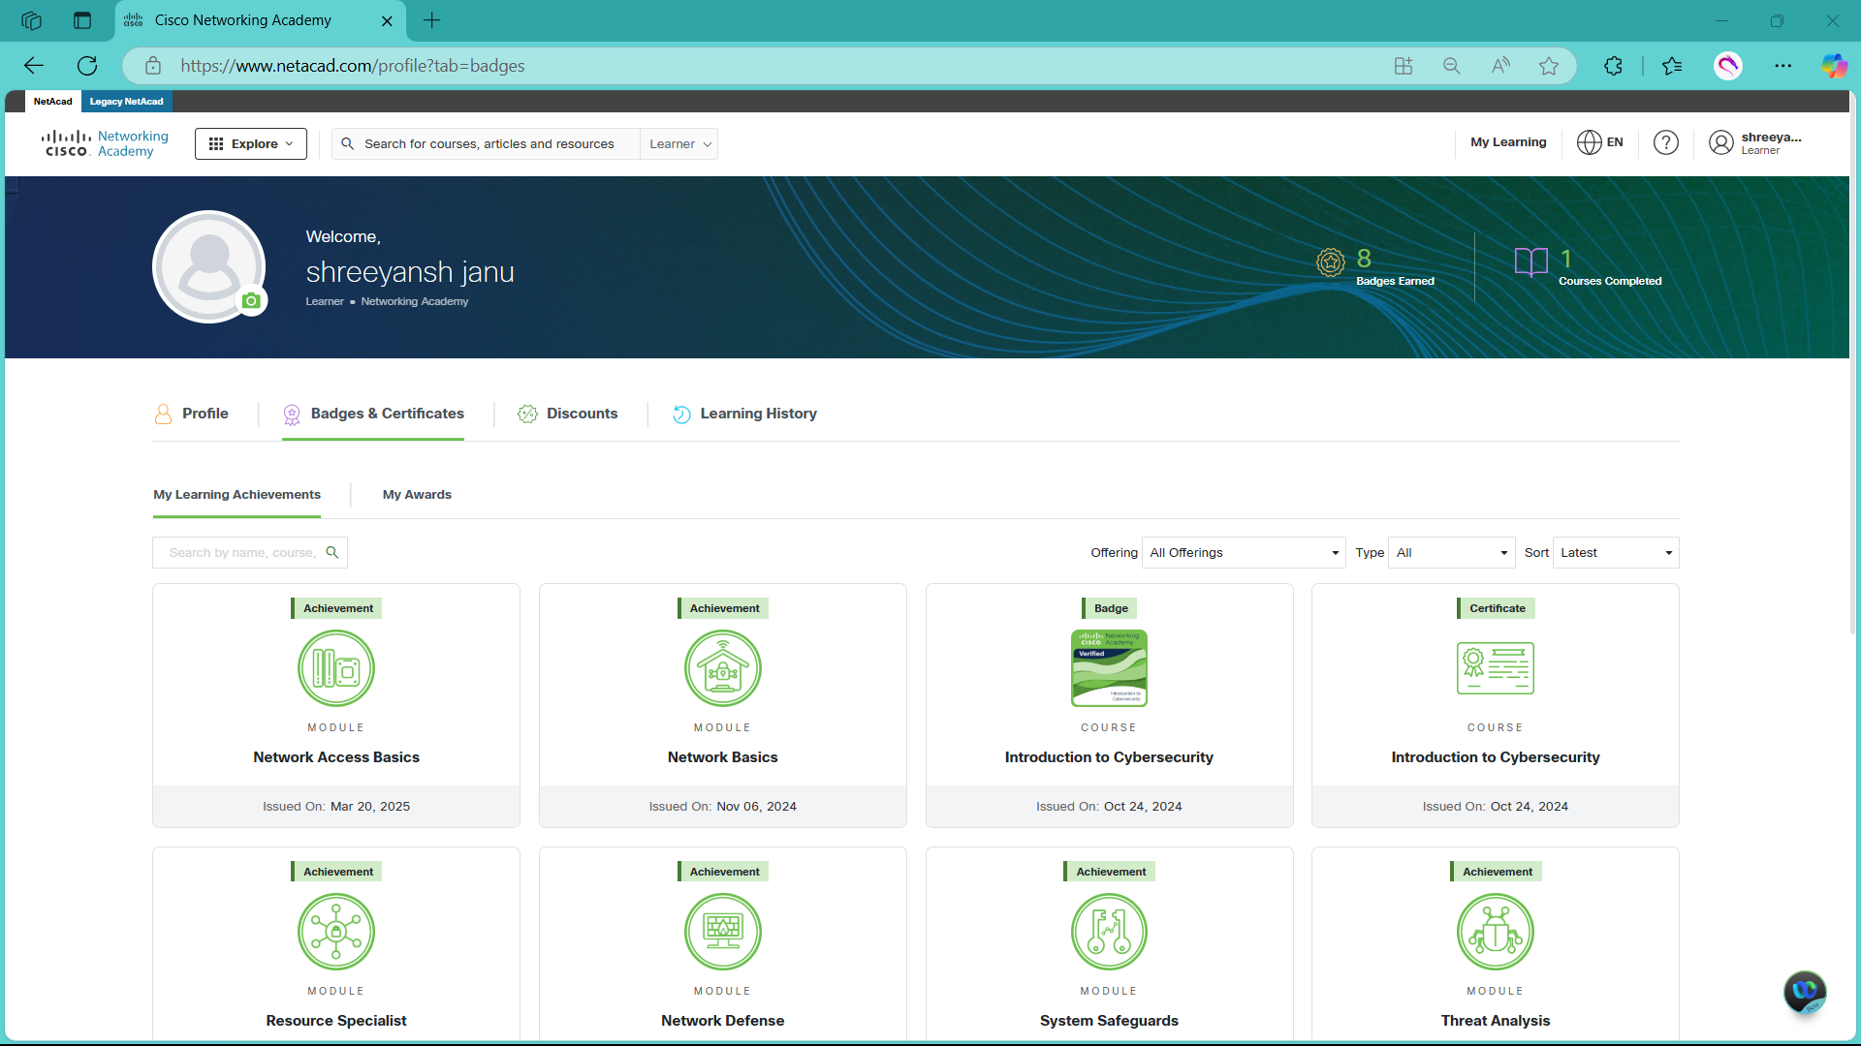
Cisco NetAcad Profile
Certificates
Networking fundamentals + introdu
Ction to cybersecurity.

